Slide 1
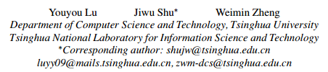
Extending the Lifetime of Flash-based Storage through Reducing Write Amplification from File Systems

Slide 2
Extending the Lifetime of Flash-based Storage through Reducing Write Amplification from File Systems
Problem
some common mechanisms in legacy file systems exacerbate flash write amplification.
1. journaling doubles the write size as the data and metadata are duplicated to
the journal logs
2. metadata is frequently written synchronously, which has a huge impact on the
memory wear
3. page updates nearly always require a read-modify-write
4. the layered design principle makes the file system and the device opaque to
each other because of the narrow block interfaces

Slide 3
Extending the Lifetime of Flash-based Storage through Reducing Write Amplification from File Systems
Solution
OFTL(object-based flash translation layer)
Lazy indexing technique
Coarse-Grained Block State Maintenance
byte-unit interfaces in OFTL: compact partial page updates and co-locate them with metadata to reduce the number of page updates

Slide 4
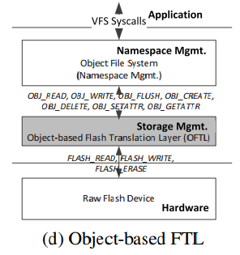
Extending the Lifetime of Flash-based Storage through Reducing Write Amplification from File Systems
OFTL-based architecture
storage management is moved from the file system to OFTL to directly manage the flash memory, so that flash properties can be investigated to optimize the file system mechanism design
directly accesses the page metadata of each flash page
OFTL manages the flash memory with read/write/erase operations
OFTL exports byte-unit access interfaces to the file system, which is an objectbased file system free from storage management and only manages the namespace

Slide 5
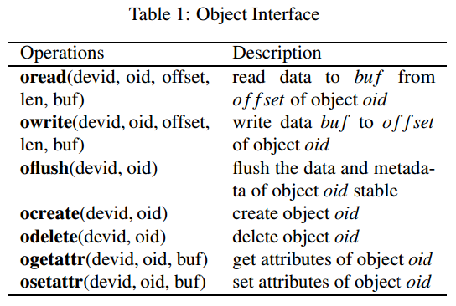
Extending the Lifetime of Flash-based Storage through Reducing Write Amplification from File Systems
OFTL Interfaces
oread/owrite interfaces pass the offset and len in byte units.Thus, OFTL gets the exact access size from the applications, making it possible to compact small updates into fewer pages
operations are made on each object with the oid given in the object interface, which makes OFTL aware of the data type of accessed pages.OFTL leverages the object semantics to cluster the update correlated data.

Slide 6
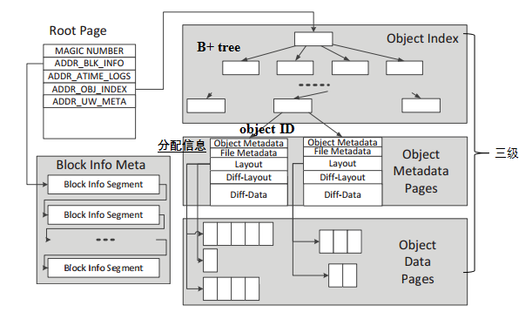
Extending the Lifetime of Flash-based Storage through Reducing Write Amplification from File Systems
OFTL Layout
(log-structured)

Slide 7
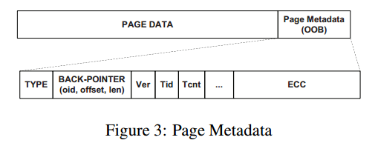
Extending the Lifetime of Flash-based Storage through Reducing Write Amplification from File Systems
Lazy indexing technique
Problem
Index persistence: The index metadata should be synchronously written to the storage device in case of data loss or inconsistency.
The frequent index persistence causes serious write amplification.
Solution
Lazy indexing technique: the type specific backpointer is employed in the page metadata of each indexed page for lazy persistence of the index metadata.
reduce the frequency of index persistence while maintaining consistency

Slide 8

ParaFS: A Log-Structured File System to Exploit the Internal Parallelism of Flash Devices
USENIX ATC '16

Slide 9
ParaFS: A Log-Structured File System to Exploit the Internal Parallelism of Flash Devices
Problem
Log-structured File System:
1.Duplicate Functions: Space Allocation, Garbage Collection.
2.Semantic Isolation: FTL Abstraction, Block I/O Interface, Log on Log.
Internal Parallelism Conflicts:
1.Broken Data Grouping : Grouped data are broken and dispatched to
different locations.
2.Uncoordinated GC Operations: GC processes in two levels are performed
out-of-order.
3.Ineffective I/O Scheduling: erase operations always block the read/write
operations, while the writes always delay the reads.
Solution
ParaFS:exploit the internal parallelism while ensuring efficient GC

Slide 10
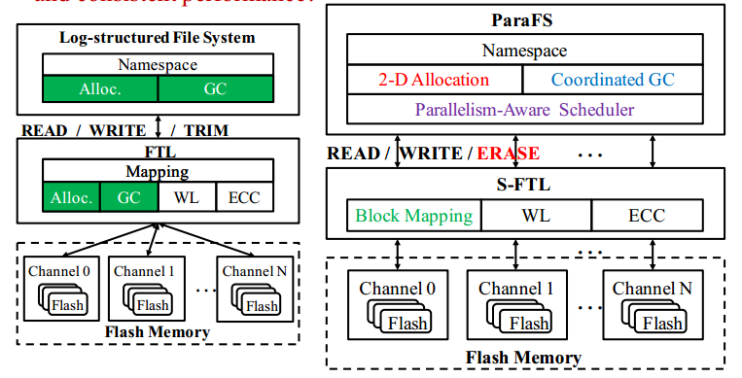
ParaFS: A Log-Structured File System to Exploit the Internal Parallelism of Flash Devices
ParaFS Architecture

Slide 11
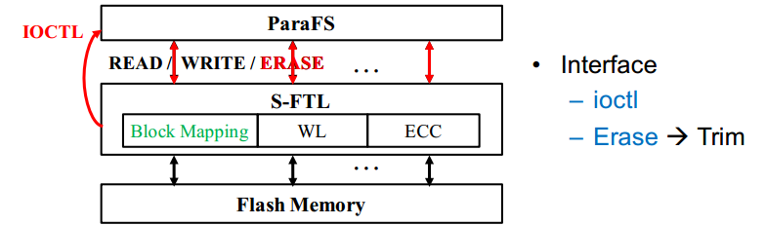
ParaFS: A Log-Structured File System to Exploit the Internal Parallelism of Flash Devices
Simplified FTL (S-FTL):
Exposing Physical Layout to FS: number of flash channels, Size of flash block, Size of flash page.
Static Block Mapping: Block-level, rarely modified.
Data Allocation Functionality is removed.
GC process is simplified to Erase process.
WL, ECC: functions which need hardware supports.
ParaFS Architecture

Slide 12
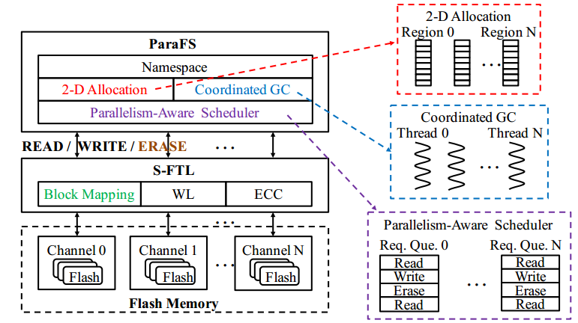
ParaFS: A Log-Structured File System to Exploit the Internal Parallelism of Flash Devices
ParaFS: Allocation, Garbage Collection, Scheduling
ParaFS Architecture

Slide 13
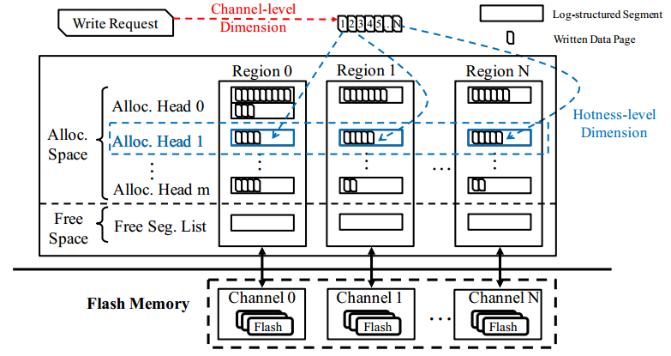
ParaFS: A Log-Structured File System to Exploit the Internal Parallelism of Flash Devices
Region → Flash Channel Segment → Flash Block Page → Flash Page
2-D Data Allocation

Slide 14

ParaFS: A Log-Structured File System to Exploit the Internal Parallelism of Flash Devices
Parallelism-Aware Scheduling
Request Dispatching Phase
Select the least busy channel to dispatch write request.
Request Scheduling Phase
Time Slice for Read Request Scheduling and Write/Erase Request Scheduling.
Schedule Write or Erase Request according to Space Utilization and Number of Concurrent Erasing Channels.

Slide 15
File Defragmentation Scheme for a Log-Structured File System

Slide 16
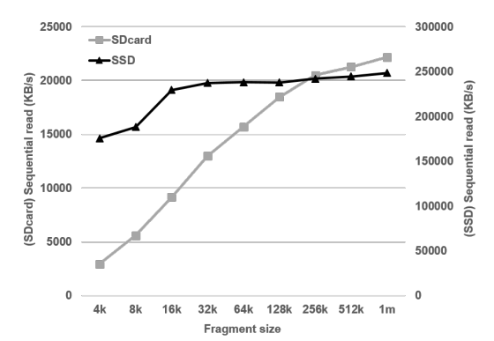
File Defragmentation Scheme for a Log-Structured File System
Problem
the write policy of LFS(log-structured file systems) can cause a file fragmentation problem, which degrades sequential read performance of the file system.
1. file fragmentation split block requests which disturb effective block I/O and
degrade I/O performance.
2. file fragmentation may cause the FTL to prefetch useless data, degrading the
read performance.
Solution
new cleaning scheme
for defragmentation

Slide 17
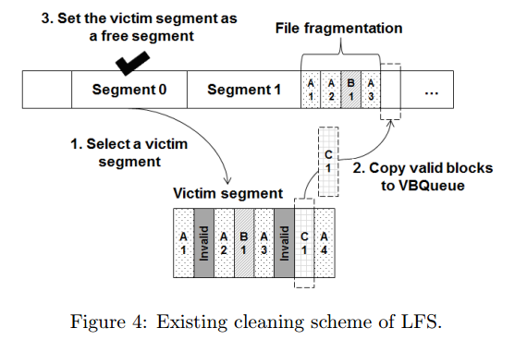
File Defragmentation Scheme for a Log-Structured File System
do not utilize the chance by copying valid blocks to a new segment in the original order, and thus consequently inherits file fragmentation.

Slide 18
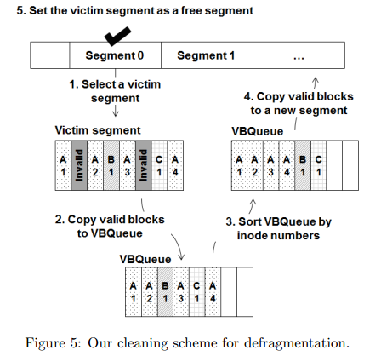
File Defragmentation Scheme for a Log-Structured File System

Slide 19
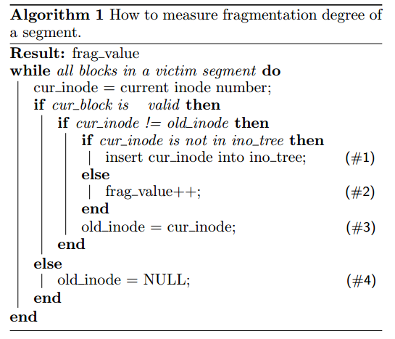
File Defragmentation Scheme for a Log-Structured File System
Existing victim selection policies cannot exploit our cleaning scheme.We suggest a fragmentation -aware victim selection policy to exploit our cleaning scheme.Our victim selection policy utilizes the fragmentation degree of each segment to select a victim segment.

Slide 20
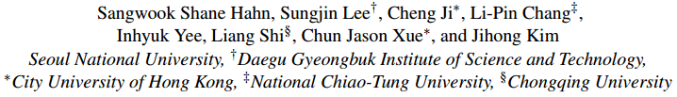
Improving File System Performance of Mobile Storage Systems Using a Decoupled Defragmenter
USENIX ATC '17

Slide 21
Improving File System Performance of Mobile Storage Systems Using a Decoupled Defragmenter
Problem
file fragmentation, which is a recurring problem (even after defragmentation), can significantly degrade I/O performance.
File fragmentation in NAND flash-based storage is quite different from conventional one in HDD:
1. Decoupled fragmentation(no correlation between logical/physical
fragmentation;Physical fragmentation rarely occurs)
2. High overhead of logical fragmentation
Solution
a novel defragger: janus defragger(janusd)
1. JanusdL defrags logical fragmentation without data copies by
remapping LBAs with FTL’s mapping table
2. JanusdP defrags physical fragmentation by improving
I/O parallelism of files

Slide 22
Improving File System Performance of Mobile Storage Systems Using a Decoupled Defragmenter
Configuration
implemented janusd on an emulated mobile flash storage, simeMMC and simUFS.
SimeMMC and simUFS, which are based on an extended Samsung 843T SSD which supports host-level FTLs,are configured to effectively simulate the bandwidth of eMMC and UFS devices, respectively.

Slide 23
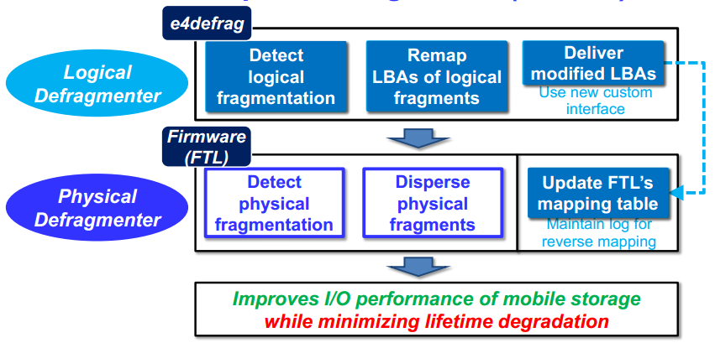
Improving File System Performance of Mobile Storage Systems Using a Decoupled Defragmenter
Overview of Decoupled Defragmenter

Slide 24
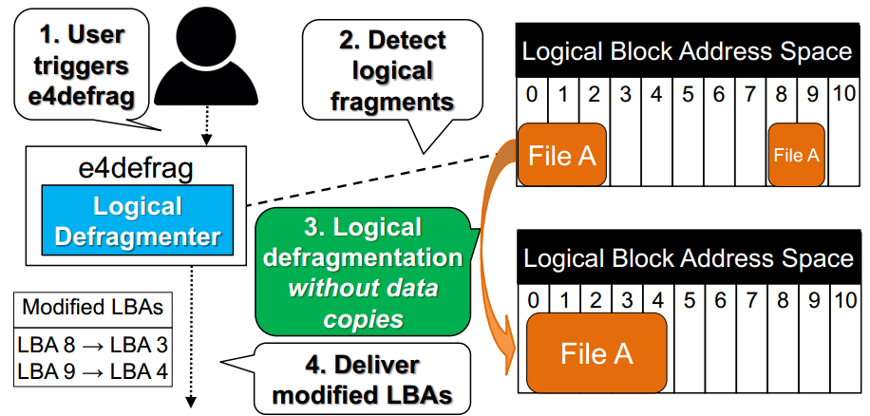
Improving File System Performance of Mobile Storage Systems Using a Decoupled Defragmenter
Logical Defragmenter (JanusdL)

Slide 25
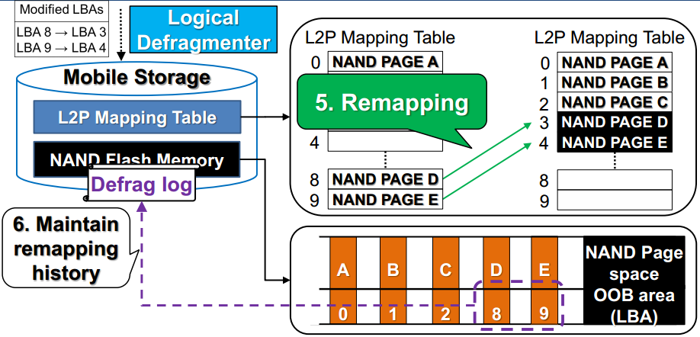
Improving File System Performance of Mobile Storage Systems Using a Decoupled Defragmenter
Logical Defragmenter (JanusdL)

Slide 26
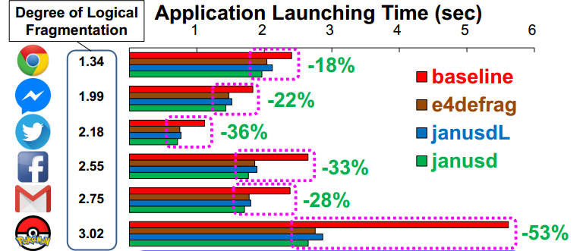
Improving File System Performance of Mobile Storage Systems Using a Decoupled Defragmenter
Application Launching Time
1. The more file fragmentation, the greater the performance improvement
2. Janusd achieves better performance than conventional defragmenter (e4defrag)

Slide 27
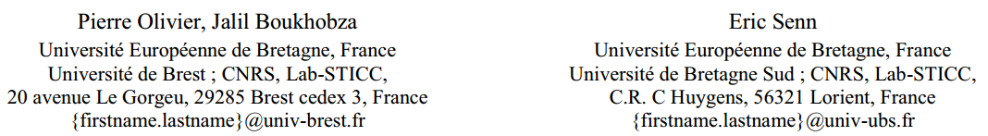
Micro-benchmarking Flash Memory File-System Wear leveling and Garbage Collection : a Focus on Initial State Impact

Slide 28
Micro-benchmarking Flash Memory File-System Wear leveling and Garbage Collection : a Focus on Initial State Impact
Problem
flash memories have particular constraints that are mainly the limited lifetime, the erase-before-write rule, and the write/erase operation granularity asymmetry.
Solution
Those peculiarities are either handled in hardware,throughout a specific controller, or in software, with the help of a dedicated Flash File System (FFS).
presents a comprehensive study on the impact of different FFS implementations of wear leveling and garbage collection on flash memory performance and lifetime according to different initial states.

Slide 29
Micro-benchmarking Flash Memory File-System Wear leveling and Garbage Collection : a Focus on Initial State Impact
Tested Hardware Platform
a Mistral tmdsevm3530 board based on OMAP 3530 EVM integrating an OMAP3530 processor (720MHz ARM Cortex-A8 / 520MHz c64x+ DSP) with 256 MB LPDDR / 256MB of NAND flash memory.
SLC Micron with a page size of 2KB and block size of 128KB.
reported latencies of the flash chip are: a read latency of 25 µs, a write latency of 200 µs, and an erase latency of 500 µs.
The Linux kernel version used is the 2.6.37 patched to include YAFFS

Slide 30
Micro-benchmarking Flash Memory File-System Wear leveling and Garbage Collection : a Focus on Initial State Impact
Performance Metrics
traditional (mean) response time
number of erase operations and wear leveling
Tools
response time:collected by the gettimeofday() system call (µs)
two benchmarking tools: uFlip and a simple complement benchmarking tool we developed from scratch
number of erase operations:Flashmon tool
Configuration
the compression was disabled for JFFS2 and UBIFS, as YAFFS2 does not natively support it

Slide 31
Micro-benchmarking Flash Memory File-System Wear leveling and Garbage Collection : a Focus on Initial State Impact
Flash Specific Benchmarking Tests
Simple sequential and random tests with saturated flash memory: performed many experimentations by varying one of the following parameters: (1) I/O request type: read or write, (2)I/O request size: from 2KB to 512KB (by powers of 2), (3) access patterns: sequential or random.
Varying flash memory fill rate / free space: used a partition of 100MB containing a test file of 20MB for I/O requests. In the rest of the flash area, we created a file that occupies respectively (for the different tests): 30%, 60% and 75% of the partition (100MB). This corresponds to having, respectively,50MB, 20MB, and 5 MB of clean space.
Varying I/O request inter-arrival times: inserted I/O timeouts between all write requests on a flash partition containing only invalid blocks to perform asynchronous garbage collection in order to recycle free space.The chosen inter-arrival times with which tests were performed are: 0ms (no inter-arrival times, used as a baseline), 10ms, and 100ms.

Slide 32
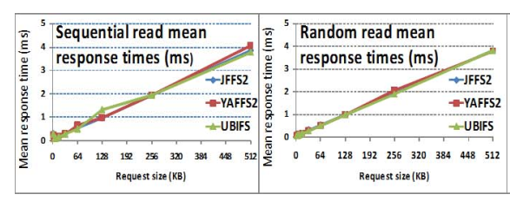
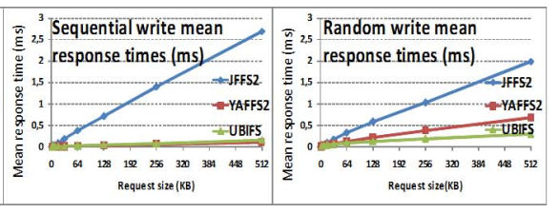
Micro-benchmarking Flash Memory File-System Wear leveling and Garbage Collection : a Focus on Initial State Impact
A. Simple tests with saturated flash memory

Slide 33
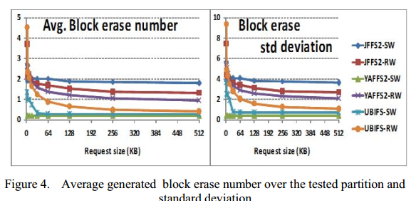
Micro-benchmarking Flash Memory File-System Wear leveling and Garbage Collection : a Focus on Initial State Impact
A. Simple tests with saturated flash memory

Slide 34
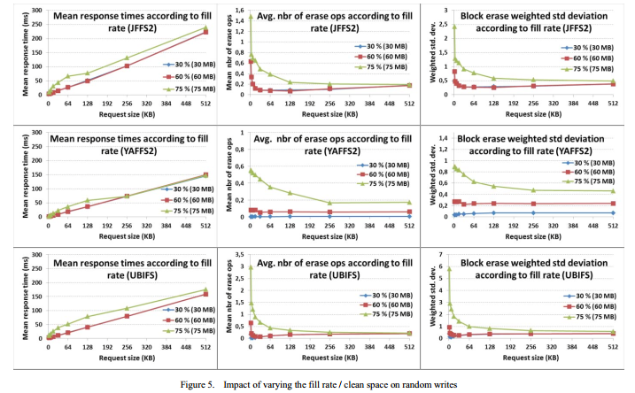
Micro-benchmarking Flash Memory File-System Wear leveling and Garbage Collection : a Focus on Initial State Impact
B. Varying flash memory fill rate / free space
(30% and 60% curves frequently overlap in the figure)

Slide 35
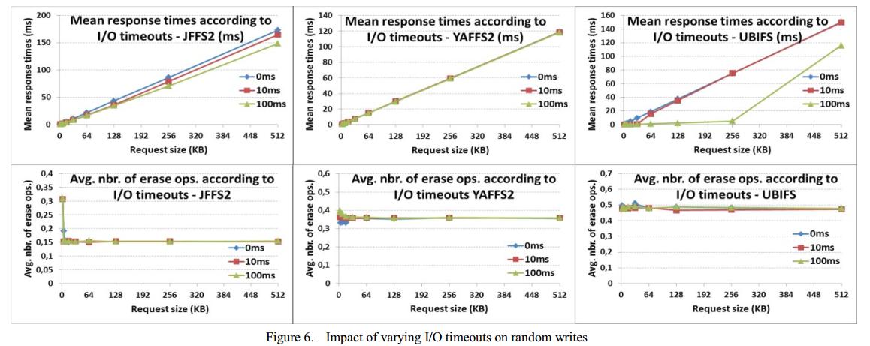
Micro-benchmarking Flash Memory File-System Wear leveling and Garbage Collection : a Focus on Initial State Impact
C.Varying I/O request inter-arrival times

